Slide 1


Senior Design Project
RiphahCapstone
Supervised By: Dr Hajra Murtaza (Assistance Professor)
SDGs: 4 - Quality Education

Slide 2
Project Team
Iman Arshad (46188)
Sana Arshad (46189)
Ayesha butt (48288)

Slide 3
Table of Content
Opportunity & Stakeholders
Solution
Progress Report Summary
Requirements
Software System (Design + Implementation + Testing)
Endeavour (Team + Work + Way of Working)
Next Steps
Prototype / Report

Slide 4
Opportunity & Stakeholders

Slide 5
Opportunity & Stakeholders
Riphah Capstone is a mandatory part of every degree but still managed manually in our university .
Manual handling causes delays, miscommunication, and uneven supervision.
There’s a need for an automated system to make the process efficient, and organized.
Our system aims to automate all stages from proposal submission to evaluation ensuring fairness and timely completion.
Notes:
The Problem: The Final Year Project (FYP/Capstone) is a mandatory part of every degree,
but in most universities, it is still managed manually using emails, paper forms, and spreadsheets.
Why This is an Issue: This manual process causes significant problems, including:
Delays in communication and feedback.
Miscommunication between students, supervisors, and coordinators.
Uneven supervision and a lack of a standardized process.
We are building an automated system to manage the entire FYP process,
from proposal submission to final evaluation. T

Slide 6
Stakeholders
Students: Create groups, submit ideas, track milestones, receive feedback.
Supervisors: Review proposals, evaluate progress, and guide students.
Coordinators/FypIncharge: Manage deadlines, monitor progress, and balance supervisor workload.
Admins: Oversee the system, manage users, and maintain data security.

Slide 7
Solution
Automates all FYP activities on a single, easy-to-use platform for students and supervisors students and supervisors
Provides checklists and feedback to keep students on track and clarify next steps.
Automates deadlines and meeting scheduling to keep teams organized and ensure timely completion.
Notes:
Our system is a single, easy-to-use platform that automates the entire Final Year Project process. Its key features are:
Centralized Platform: It brings all FYP activities for students and supervisors onto one platform.
Automated Scheduling: It automates deadlines and meeting scheduling to keep teams organized and ensure projects are completed on time.
Guidance Tools: It provides clear checklists and feedback tools to keep students on the right track and clarify their next steps.

Slide 8
PROGRESS REPORT Summary

Slide 9
Requirements
Elicitation Techniques / Tools
Research
Document
AnalysisSelf-Experience (Participant Observation)
Observation

Slide 10
Specification / Documentation
List of Different Users
Student:
Register & form groups
Submit ideas & proposals
Select supervisor
Track milestones
Manage tasks
Supervisor:
Review ideas & proposals
Evaluate milestones
Give feedback & notes
Manage meeting slots

Slide 11
Users
Coordinator:
Set deadlines
Upload templates
View Group
Post announcements
Admin:
Manage all user accounts
Approve students & ensure security

Slide 12
Use Cases
Register / Login
Approve / Unapprove Student Account
Configure Upload (Excel Upload)
Create Group
Join / Invite Members
Select Supervisor
Manage SupervisorSlots
Submit Project Idea
AI Title Rewrite Download Template
Role-Based Access Control

Slide 13
UseCases
Approve / Reject Proposal
Schedule Meeting
Post Whiteboard Note
Upload Milestones
Submit Proposal
Evaluate Milestone (Rubric-Based)
View Timeline
Send / Receive Notifications (Noticeboard)

Slide 14
Requirements
Functional Requirements
Secure User Registration & Authentication for Students, Supervisors, Coordinators, and Admins
Role-Based Access Control (RBAC) for feature visibility and permissions
Group Formation up to three members with leader control
Project Idea Submission & Review by supervisors
AI-Powered Project Title Rewriter for improved project titles
Supervisor Selection based on expertise and availability
Proposal Finalization & Submission using standard templates
Template Enforcement & Auto-Download for official formats

Slide 15
Requirements
Google Drive Auto Backup for all submissions
FYP Journey Journal auto-generated weekly activity reports
Project Archive & Search for completed FYPs
Reporting Module (PDF / Excel export)
Noticeboard for announcements and updates
Excel Upload (Admin) for bulk user registration
Change Password (first login / anytime)
Supervisor Slot Management with capacity control
Approved Students verification by Admin

Slide 16
Requirements
Non-Functional Requirements
Reliability
Usability

Slide 17
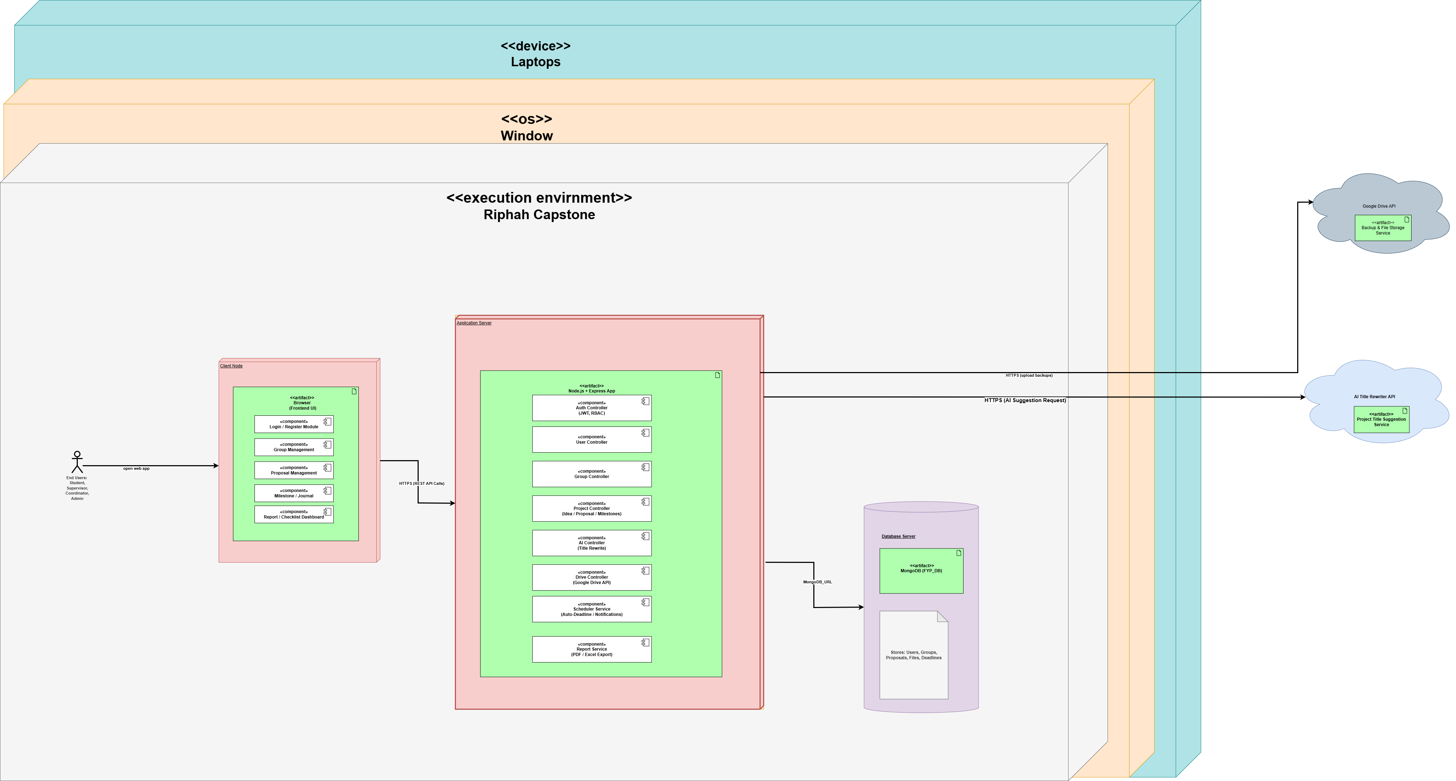
Deployment Diagram

Slide 18
Design
Detailed Design
Use case diagram
Package diagram
Activity diagram
Json tree diagram

Slide 19
Implementation
List Development Tools & Technologies
HTML
CSS
JS
Node.js
React
mongodb
MS Word
Visual Studio
Draw.io
Postman

Slide 20
Implementation
List Best Practices / Coding Standards
Component-based development for modular UI (AppTable, DashboardSectionHeader)
Isolated API calls using dedicated service files
Separate controllers for each business logic block

Slide 21
Implementation
List Libraries / Components / Web Services
Material UI (MUI)
Tailwind CSS
Axios
Chart.js
xlsx
MongoDB
OpenRouter AI
Google Drive
GitHub
Node.js / Express.js

Slide 22
Testing
Black Box Testing:
Validated system behavior using different inputs and outputs.
Tested modules like Registration, Login, Proposal Submission, etc.
Functional Testing:
Ensured each system function performs as expected (e.g., Register, Login, Submit Proposal, Schedule Meeting).

Slide 23
Endeavour

Slide 24
Endeavour
Describe roles of your team members
SDLC Phase | Team Members Responsible
Requirement Gathering | Iman, Sana, Ayesha
Design Phase | Iman, Sana
Implementation / Development | Iman, Sana, Ayesha
Testing Phase | Iman, Ayesha

Slide 25
Endeavour
Describe your software development process
Design / Sprint Planning: System architecture, database schemas, UML diagrams per sprint
Implementation / Coding: Frontend & backend development iteratively; modules integrated continuously
Requirement Analysis / Backlog Creation: Gather requirements, create use cases, maintain documentation
Testing: Manual testing of features and workflows
Deployment / Sprint Release: Server setup, database integration, version control via GitHub
Maintenance / Iterative Improvement: Post-deployment bug fixes, updates, and enhancements

Slide 26
Endeavour
Describe your way of working as a team
Communication Tools: Zoom for meetings, Physical meetings , WhatsApp for quick updates
Task Management: ClickUp for assigning and tracking tasks
Version Control: GitHub repository for code collaboration
Collaboration: Equal responsibility sharing, peer reviews, daily/weekly check-ins
Workflow: Plan → Design → Develop → Test → Deploy → Maintain
Physical meetings: Regular physical meetings were conducted at the university.

Slide 27
NEXT STEPS

Slide 28
Work Breakdown Structure (List of all Deliverables / Strikethrough Completed Deliverables)
Reports & Documentation
Introduction
Literature Survey
Requirement Analysis
System Design
Implementation(in progress)
Testing & Evaluation(in Progress)
Conclusion & Outlook
System
Authentication module
Community/User module
Researcher module
AI Model
Admin Module

Slide 29
Challenges
No benchmark or reference model made system design and structuring more challenging.
Confusion arose due to inconsistent role names between the handbook and university.
e.g : Handbook used coordinators instead of FYP Incharge

Slide 30
Prototype & Report

Slide 31
Report
Chapter 1: Introduction
Chapter 2: Literature / Market Survey
Chapter 3: Requirement Analysis
Chapter 4: System Design
Chapter 5: Implementation
Chapter 6: Testing & Evaluations
Chapter 7: Conclusion & Outlook

